Slide 1
Chapter 7
LTM: Encoding, Retrieval, and Consolidation
Notes:
Hi Everyone, this video is part 2 of our discussion on long-term memory. In chapter 6, we discussed how long-term memory is structured. Chapter 7 shifts the focus to how information is stored in LTM and how we retrieve information when we need it. Let’s get started!

Slide 2
Getting Information Into LTM
Encoding: acquiring information and transforming it into memory
Retrieval: transferring information from LTM to working memory
Maintenance rehearsal
  Repetition of stimuli that maintains information but does not transfer it to LTM
Elaborative rehearsal
  Using meanings and connections to help transfers information to LTM
Notes:
I’d like to start this video out by defining some key terms for you.

Slide 3
Levels of Processing Theory (1 of 2)
Memory depends on how information is encoded!
Depth of processing
  Shallow processing
    little attention to meaning
    focus on physical features
    poor memory
  Deep processing
    close attention to meaning
    better memory

Slide 4
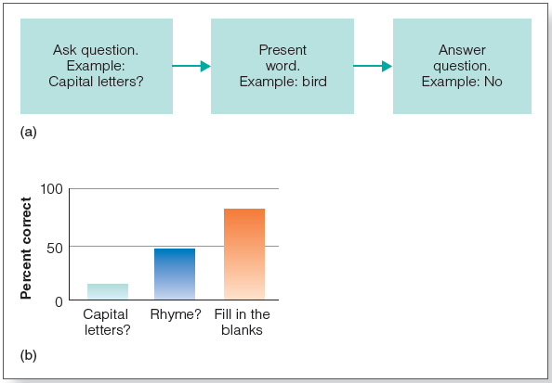
Levels of Processing Theory (2 of 2)
Notes:
Figure 7.1 (a) Sequence of events in Craik and Tulving’s (1975) experiment. (b) Results of this experiment. Deeper processing (fill-in-the-blanks question) is associated with better memory.

Slide 5
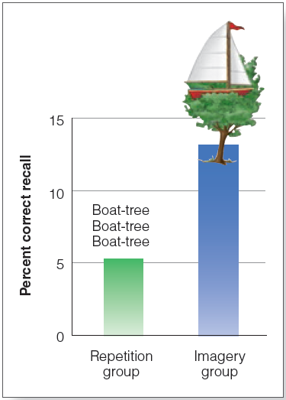
Other Factors That Aid Encoding
Visual imagery
Self-reference effect
Generation effect
Organizing to-be-remembered information
Relating words to survival value
Retrieval practice
Notes:
Figure 7.2 Results of the Bowerand Winzenz (1970) experiment. Participants in the repetition group repeated word pairs. Participants in the imagery group formed images representing the pairs.

Slide 6
Organization, Comprehension, and Memory (1 of 2)
Bransford & Johnson (1972)
Presented difficult-to-comprehend information
  Experimental Group 1 saw picture that helped explain the information before reading it
  Experimental Group 2 saw picture after reading the passage
  Control Group did not see the picture
Group 1 outperformed the others!
  Having a mental framework of comprehension aided memory encoding and retrieval

Slide 7
Retrieval Practice Effect
Karpicke and Roediger (2008) study-and-test experiment with word pairs
  Group 1: studied and tested all words/all sessions
  Group 2: studied only words missed in previous tests; tested on all words
  Group 3: studied all words; tested only on words missed in previous tests
Group 3 later performance < than Groups 1 and 2!
  Shows testing memory retrieval can improve memory.

Slide 8
Design and Result of Karpicke and Roediger (2008) Experiment
 | First Study and Test Session: STUDY | First Study and Test Session: TEST | Repeat Study and Test Session: STUDY | Repeat Study and Test Session: TEST | Test After One Week % Correct
Group 1 | All Pairs | All Pairs | All Pairs | All Pairs | 81
Group 2 (less studying) | All Pairs | All Pairs | Only pairs NOT recalled in previous tests | All Pairs | 81
Group 3 (less testing) | All Pairs | All Pairs | All Pairs | Only pairs NOT recalled in previous tests | 36

Slide 9
Retrieving Information from LTM (1 of 2)
Retrieval: process of transferring information from LTM back into working memory (consciousness)
  Most of our failures of memory are failures to retrieve!

Slide 10
Retrieving Information from LTM (2 of 2)
Cued recall:
  Most of our failures of memory are failures to retrieve
  Cue presented to aid recall
  Increased performance over free recall
  Retrieval cues most effective when created by the person who uses them

Slide 11
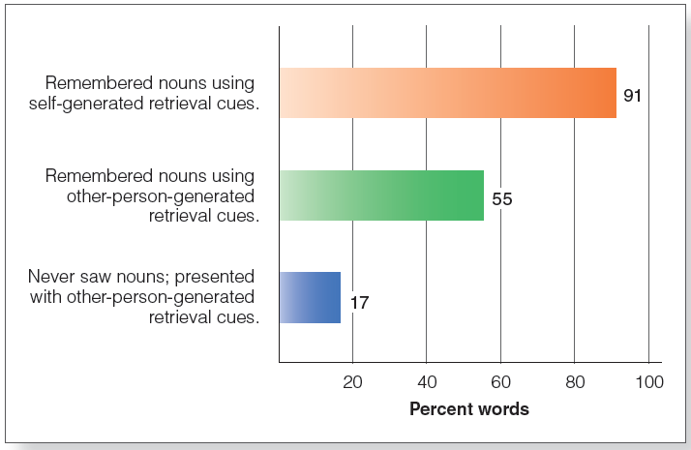
Retrieving Information from LTM (2 of 2)
Notes:
Figure 7.7 Results of Mantyla’s (1986) experiment. Memory was best when retrieval cues were created by the participant (top bar), and not as good when retrieval cues were created by someone else (middle bar). Control participants who tried to guess the words based on retrieval cues generated by someone else did poorly (bottom bar).

Slide 12
Encoding Specificity
We learn information together with its context
Baddeley’s (1975) “diving experiment”
  Best recall occurred when encoding and retrieval occurred in the same location

Slide 13
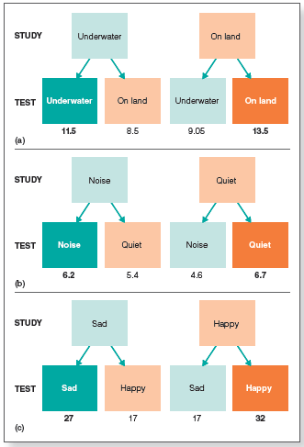
Notes:
Figure 7.8 Design and results for (a) Godden and Baddeley’s (1975) “diving” experiment; (b) Grant et al.’s (1998) “studying” experiment; (c) Eich and Metcalfe’s (1989) “mood” experiment. Results for each test condition are indicated by the number directly under that condition. The matching colors (light green to dark green, and light orange to dark orange) indicate situations in which study and test conditions matched.

Slide 14
State-Dependent Learning
Learning is associated with a particular internal state
  Better memory if person’s mood at encoding matches mood during retrieval

Slide 15
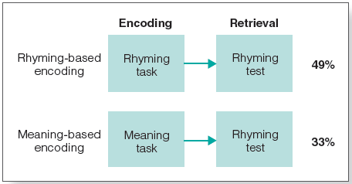
Matching the Cognitive Task
Transfer-appropriate processing
  memory task results improve if the type of processing used during encoding is the same as the type during retrieval
Morris et al. (1977)
Notes:
Figure 7.9 Design and results for the Morris et al. (1977) experiment. Participants who did a rhymingbased encoding task did better on the rhyming test than participants who did a meaning-based encoding task. This result would not be predicted by levels of processing theory but is predicted by the principle that better retrieval occurs if the encoding and retrieval tasks are matched.

Slide 16
Consolidation (1 of 3)
Transforms new memories from fragile state to more permanent state
  Synaptic consolidation: rapid, occurs at synapses
  Systems consolidation: gradual, reorganization of neural circuits

Slide 17
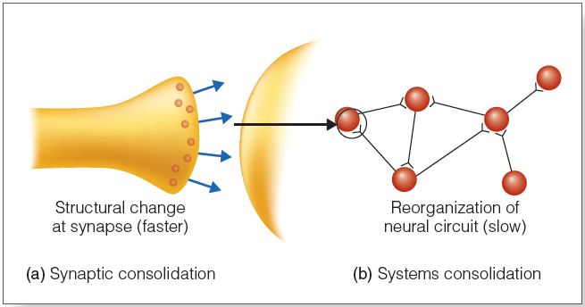
Consolidation (2 of 3)
Notes:
Figure 7.11 Synaptic and systems consolidation. (a) Synaptic consolidation involves changes at the synapses. (a) Systems consolidation involves reorganization of neural connections and takes place over a longer time span.

Slide 18
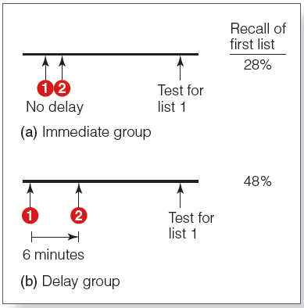
Consolidation (3 of 3)
Müller and Pilzecker (1900)
Notes:
Figure 7.10 Procedure for Müller and Pilzecker’s experiment. (a) In the immediate (no delay) condition, participants used the first list (1) and then immediately learned the second list (2). (b) In the delay condition, the second list was learned after a 6-minute delay. Numbers on the right indicate the percentage of items from the first list recalled when memory for that list was tested later.

Slide 19
Synaptic Consolidation (1 of 2)
Hebb (1948)
  Learning and memory represented in the brain by physiological changes at the synapse
  Neural record of experience
Long-term potentiation (LTP)
  Enhanced firing of neurons after repeated stimulation
  Structural changes and enhanced responding

Slide 20
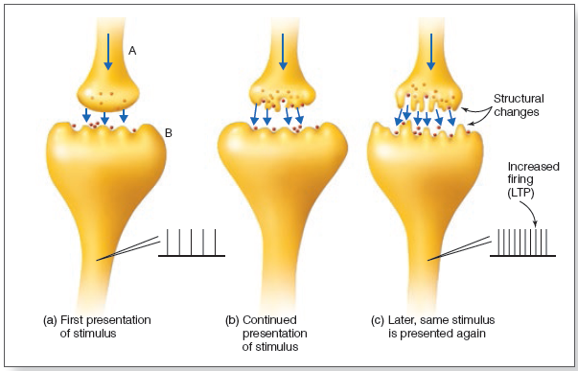
Synaptic Consolidation (2 of 2)
Notes:
Figure 7.12 What happens at a synapse as (a) a stimulus is first presented. The record next to the electrode indicates the rate of firing recorded from the axon of neuron B. (b) As the stimulus is repeated, structural changes are beginning to occur. (c) After many repetitions, more complex connections have developed between the two neurons, which causes an increase in the firing rate, even though the stimulus is the same one that was presented in (a).

Slide 21
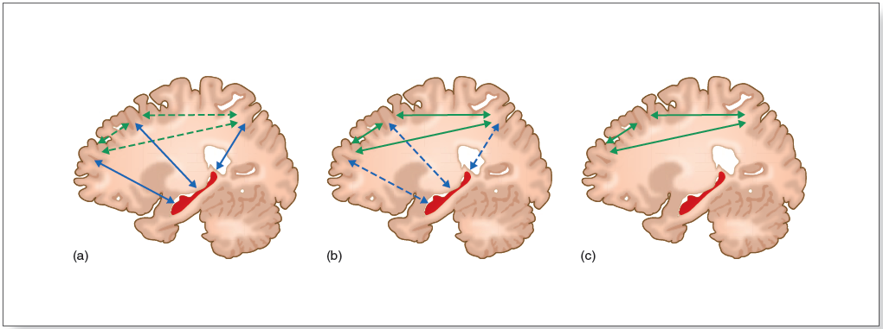
Systems Consolidation
Standard model of consolidation
  After encoding, activity of hippocampus fades with time
Notes:
Figure 7.13 Sequence of events that occur during consolidation, according to the standard model of consolidation. (a) Connections between the cortex and the hippocampus (blue) are initially strong and connections between cortical areas are weak (dashed green). The activity between the hippocampus and cortex is called reactivation. (b) As time passes, connections between the hippocampus and cortex weaken (dashed blue) and connections between cortical areas become stronger (green). (c) Eventually, only intercortical connections remain.

Slide 22
Memory Loss and Injury (1 of 2)
Standard model of consolidation based partly on observation of injury/trauma-related memory loss
Retrograde amnesia: loss of memory for events prior to the trauma
Graded amnesia: memory for recent events is more fragile than for remote events

Slide 23
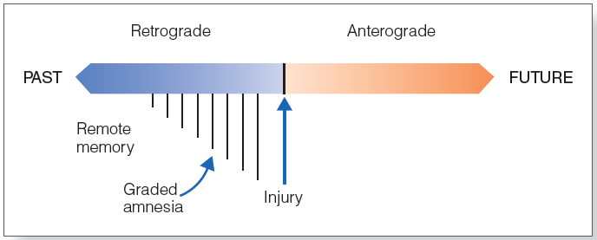
Memory Loss and Injury (2 of 2)
Notes:
Figure 7.14 Anterograde amnesia is amnesia for events that occur after an injury (the inability to form new memories). Retrograde amnesia is amnesia for events that happened before the injury (the inability to remember information from the past). The vertical lines, which symbolize the amount of retrograde amnesia, indicate that amnesia is more severe for events or learning that were closer in time leading up to the injury. This is the graded nature of retrograde amnesia.

Slide 24
Systems Consolidation
Multiple trace model of consolidation
  Hippocampus is activated during retrieval of both recent and remote memories (Gilboa and coworkers, 2004)
  Response of the hippocampus can change over time (Viskontas and coworkers, 2009)

Slide 25
Consolidation and Sleep
Memory consolidation appears to be enhanced during sleep (Gais et al., 2006)
  One reason: sleeping stops interference from environmental stimuli
Some memories are consolidated more than others (Wilhelm et al., 2011)
  Memory for task was stronger when participants expected to be tested after awaking

Slide 26
Reconsolidation: Memory Updating
Retrieved memories become fragile and are consolidated again → reconsolidation
Nader et al. (2000): rat experiment
Hupbach et al. (2007): human reconsolidation experiment
Memory is a “work in progress” … constantly constructed and remodeled in response to learning and conditions

Slide 27
Reconsolidation and PTSD
Posttraumatic stress disorder causes severe emotional responses to traumatic memories
Brunet et al. (2008)
  Participants reactivated a traumatic memory
  Drug administered to block amygdala stress receptors during reconsolidation of memory
  Later reactivation of same memory showed lower stress responses

Slide 28
Memory and Effective Studying
Elaborate—associate what you are learning to what you already know
Generate questions and self-test
Take breaks
  Spacing effect: Memory is better for multiple short study sessions
  Consolidation is enhanced by sleep after studying
Avoid the “illusion of learning”
  Familiarity does not mean comprehension

